Slide 1

A PRESENTATION BY THE GUEST SPEAKER MR. HAYATUDDEEN A. AWWAL, _{FNIQ} MANAGING DIRECTOR/CEO OF FHA MORTGAGE BANK (FHAMB) LIMITED
AT
THE 4TH ANNUAL NIGERIA AFFORDABLE HOUSING FINANCE & INNOVATION SUMMIT & EXPO ON 9TH & 10TH NOVEMBER, 2021 AT THE NAF CONFERENCE CENTRE, ABUJA.

Slide 2
TOPIC:
The Role of Primary Mortgage Banks in Facilitating Mortgage Origination: FHA Mortgage Bank’s Experience.

Slide 3
0
Introduction:
FHA Mortgage Bank (FHAMB) Limited is a Nigerian based Primary Mortgage Bank (PMB). It was incorporated by Federal Housing Authority (FHA) as a wholly owned subsidiary in 1997 and licensed to commence business as a Primary Mortgage Bank (PMB) in 1999 under the regulatory authorities of CBN and NDIC. We are focused on Mortgage Origination and Facilitating Access to home ownership to Nigerians. The Bank is fully incorporated with the Corporate Affairs Commission (CAC) and our Registration Number is RC 314882.
Core Manadate:
As a Primary Mortgage Bank, we are permitted to engage in the following Business Activities;
Mortgage Financing.
Real Estate Construction Finance within the permitted limits.
Acceptance of Savings and Time/Term deposits.
Acceptance of Mortgage Focused Demand Deposits.
Mortgage Funds (e.g. National Housing Funds Facility) for On-Lending.
Advisory Services as it relates to Construction and Mortgage Origination.

Slide 4
Our Services:
In order to meet up with our organizational goal of being the Mortgage Bank of choice and generating profitability for our shareholders, we provide the following services to our esteemed customers.
Mortgage Origination Administration.
Advisory Services to Estate Developers, Agents, Ministries, Departments, Agencies and Individuals.
Business Development.
Real Estate Development Construction financing.
Financing and Consultancy as it relates to Housing Value Chain
National Housing Funds (NHF) loan processing.
Retail Banking related activities.
Portfolio Investment Management and Administration.
Money Deposit Bank.

Slide 5

Our Team:
The FHAMB Team is made up of highly motivated staff who are very aggressive, creative, committed, determined, focused, innovative and polite. We know our numbers very well, number is the name of our game/business. Together we generate these numbers and are disposed to doing so by:
Profiling of customers towards determining their Mortgage Affordability.
Rendering seamless and easy Loan Processing Services that accommodate both Shelter Seekers and Home Seekers;
Creating achievable thoughts of home ownership in the hearts of our teaming customers and the general public;
Strategic focus on creating end-user-driven, affordable home-ownership housing schemes for Nigerians in the Low, Medium and High income brackets;
Generating Marketing Partnership with Genuine Developers to bridge the gap and reduce housing deficits in Nigeria;
Promoting high level advocacy and sustainable collaboration with all stakeholders (Formal and Informal) in the housing sector.

Slide 6
Partnership with Federal Mortgage Bank (FMBN):
FHAMB’s partnership with FMBN is in two fold. One is in the aspect of Accessing the National Housing Fund (NHF) Scheme and the other is the Sales of Funded Estates across Nigeria.
National Housing Funds (NHF) Loans Accessed for Nigerians:
This is one of the major activities of the Bank and since June, 2015 when the present Management Team came on Board so much NHF Loans have been accessed for Nigerians by the Bank (FHAMB) from FMBN as summarised in the table below:
YEAR | NO. OF NENERFICIARIES | AMOUNT ACCESSED (N)
From inception up to 2015 | 61 | 397,277,500.00
2016 | 4 | 28,950,000.00
2017 | 71 | 631,087,000.00
2018 | 297 | 2,971,070,160.00
2019 | 645 | 6,199,285,166.00
2020 | 493 | 4,515,093,300.00
2021 | 693 | 7,236,043,057.60
TOTAL | 2,264 | 21,978,806,183.60

Slide 7
PROCESS FLOW:
FHAMB in playing its role as a Primary Mortgage Bank (PMB), always articulates process flows for any mortgage business or marketing partnership it is involved in towards determining project dynamics. A typical one we would like to discuss today is the Process Flow articulated for FMBN Funded Estates:
Interested applicants (either from the formal or informal sector of the economy) must be contributors to the NHF Scheme.
Applicants must obtain and complete FMBN FUNDED ESTATES Houses Order/Application Form at a non-refundable fee of N500.00 only.
Applicant submits FMBN FUNDED ESTATE House Order/Application Form to FHAMB.
FHAMB (the Bank) collects Applicant’s Data for profiling.
Each Profiled and Pre-Qualified Applicant opens an Individual Current Account with the PMB.
Letter of House Offer/Allocation will be issued to each Profiled and Pre-Qualified Applicant.
Each Applicant with a Letter of House Offer/Allocation obtains and Completes NHF Loan Application Form.
Applicant submits completed NHF Loan Application Form to the FHAMB.
Applicant deposits Equity Contribution in his/her Account with the FHAMB where applicable.
PMB retains Applicant’s Equity Contribution until NHF Loan is approved where applicable.
PMB processes Applicants NHF Loan Application’s, Batches and submits them to FMBN for further processing; and follows up until approval is secured/obtained.
FMBN forwards approved Batched NHF Applications to the PMB.
PMB accepts approved NHF Loans from FMBN within 60 Days.
PMB issues NHF Loan Offer Letters to Applicants.
Applicants accept NHF Loan Offered.
PMB follows up on NHF Loan Disbursement with FMBN.
FMBN disburses what is due to FHAMB and settle the Balance through inter-account settlement.
FHAMB informs the beneficiaries’ employers of the successful completion of the loan cycle.
PMB obtains instruction(s) from individual beneficiary’s pay point or salary payment source to commence loan repayments.
Title and other Relevant Documents to the houses shall be processed by approved Legal Practitioner at the relevant State Land Registry or as directed/prescribed by FMBN.
On Full Liquidation of the NHF Loan, each Beneficiary’s Security/Collateral Documents are released to him/her.
The whole process terminates at this point.

Slide 8
FHAMB SUCCESS STORY: In today’s business world, collaboration and leveraging are keys to success; and FHA Mortgage Bank Limited has deployed these two keywords in doing its business. This relationship depended business model has yielded so much results which can be seen in the tables below:
Partnership with Federal Housing Authority:
Partnership with Federal Housing Authority:
S/NO | NAME OF ESTATE | LOCATION | TOTAL NO. OF UNITS | TOTAL AMOUNT (N)
1 | 50-50 Unbeatable Offer at Gwarimpa | Gwarimpa, Abuja | 128 | 1,451,991,214.22
2 | 50-50 Unbeatable Offer at Lugbe | Lugbe, Abuja | 18 | 107,000,000.00
3 | Obada-Oko | Ogun | 97 | 890,000,000.00
4 | Gombe Housing Estate | Gombe | 72 | 693,600,000.00
5 | Gonin-Gora Housing Estate | Kaduna | 85 | 666,500,000.00
6 | Abesan-13 Estate | Iyana-Ipaja, Lagos | 71 | 1,065,000,000.00
7 | Yenagoa | Yenagoa, Bayelsa | 80 | 2,955,600,000.00
8 | Odukpani | Odukpani, Cross River | 83 | 841,000,000.00
9 | Paradise Hill | Apo-Guzape, Abuja | 40 | 3,071,000,000.00
10 | Zuba | Zuba, Abuja | 24 | 156,000,000.00
 |  | TOTAL | 698 | 11,897,691,214.22

Slide 9
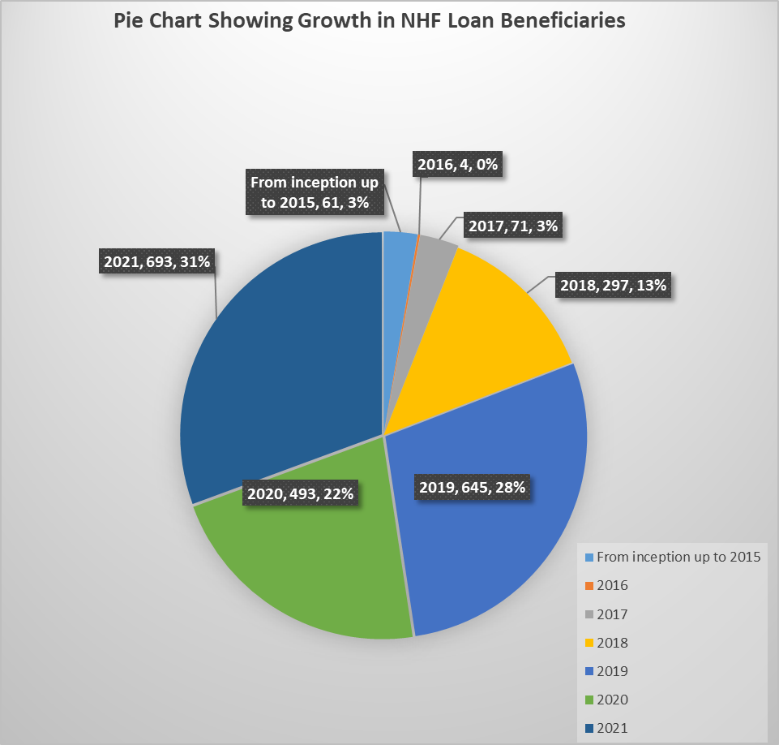
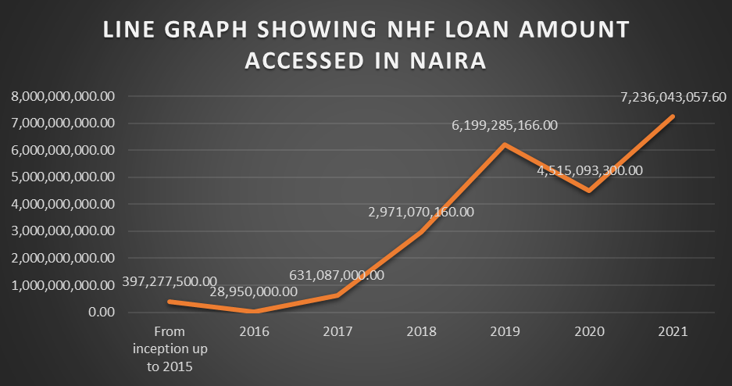

Slide 10
Marketing and Sales of FMBN Funded Estates:
As a result of the proactive marketing, innovative, strategic and creative stands of FHAMB, the PMB was given an award of excellence by FMBN and was appointed to market and sale various FMBN Funded Estates across the Country (in Abuja, Kaduna, Kano, Sokoto, Katsina, Borno, Taraba and Lagos States) the details are as enumerated in the table below:
STATE | TOTAL NO. OF UNITS | TOTAL AMOUNT (N)
Abuja (Kuje & Gwagwalada) | 508 | 2,882,192,000.00
Kaduna (Millennium City) | 200 | 4,308,400,000.00
Kano (Western By Pass) | 86 | 4,308,400,000.00
Sokoto | 100 | 683,600,000.00
Katsina | 202 | 684,400,000.00
Borno | 324 | 612,200,000.00
Taraba | 300 | 1,192,000,000.00
Lagos (Ikorodu) | 112 | 795,360,000.00
TOTAL | 1,832 | 15,466,552,000.00

Slide 11
Partnership with Genuine Developers (GDs):
Here, Memorandum of Understandings (MOUs) are executed before commencement of marketing and sales and details of what we have done so far are as given below:
S/NO | NAME OF ESTATE | DEVELOPER | LOCATION | TOTAL NO. OF UNITS | TOTAL AMOUNT (N)
1 | Palms | Pirotti Projects & Properties Ltd | Dawaki, Abuja | 18 | 362,850,000.00
2 | Belham | BAM Projects & Properties Ltd | Karsana, Abuja | 100 | 1,575,000,000.00
3 | Belham | BAM Projects & Properties Ltd | Lugbe, Abuja | 48 | 1,915,000,000.00
4 | PTAD | Precise Estate Developers | Wumba, Abuja | 45 | 765,000,000.00
5 | WoodHill | Perfect Estate Developers Ltd | Kuje, Abuja | 77 | 651,500,000.00
6 | Southend | Mercy Samuelson | Kyami, Abuja | 23 | 300,000,000.00
7 | Open Freedom | Opinior Engineering | Kuje, Abuja | 50 | 262,845,000.00
8 | Opengate | Zeecrest Vantage Ltd | Karmo, Abuja | 39 | 843,000,000.00
9 | Opengate | Zeecrest Vantage Ltd | Dawaki, Abuja | 22 | 429,000,000.00
10 | Express View | Mixta Africa | Lugbe, Abuja | 52 | 2,860,000,000.00
11 | Paradise Hills | FHA/ENL | Apo-Guzape, Abuja | 40 | 1,336,000,000.00

Slide 12
Partnership with Genuine Developers (GDs) Cont’d.:
S/NO | NAME OF ESTATE | DEVELOPER | LOCATION | TOTAL NO. OF UNITS | TOTAL AMOUNT (N)
12 | Beracah | Beracah Global Homes Ltd | Kuje, Abuja | 24 | 336,000,000.00
13 | Lake View Residences | Standard Structures Ltd | Plot 185 Katampe Extension, Abuja | 2 | 60,000,000.00
 | Fair View Residences | Standard Structures Ltd | Plot 68 Katampe Extension, Abuja | 10 | 300,000,000.00
 | Rehoboth Residences | Standard Structures Ltd | Plot 185 Jahi, Abuja | 7 | 175,000,000.00
 | Diplomatic Residences | Standard Structures Ltd | Plot 280 Katampe Extension, Abuja | 14 | 770,000,000.00
 | Fair View Apartments | Standard Structures Ltd | Area 1, Garki, Abuja | 9 | 157,500,000.00
TOTAL |  |  |  | 580 | 13,098,695,000.00

Slide 13
Partnership with Family Homes Funds (FHF):
Similarly, the Bank has executed an MOU with FHF to promote the sales through the provision mortgages for houses developed and funded by FHF in the following locations:
ESTATE AND LOCATION | TOTAL NO. OF UNITS | TOTAL AMOUNT (N)
Luvu Estate, Nasarawa | 50 | 174,500,000.00
Millennium City, Kaduna | 95 | 850,000,000.00
Abirba, Delta | 150 | 1,112,500,000.00
Ogun | 105 | 817,500,000.00
Birnin-Kebbi, Kebbi | 500 | 2,250,000,000.00
Giri, Abuja | 1,000 | 4,500,000,000.00
TOTAL | 1,900 | 9,704,500,000.00

Slide 14
CHALLENGES/CONCLUSION/RECOMENDATION:
CHALLENGES:
Non-availability of Mortgage-able Homes (i.e. homes that have the right designs, right Government approvals, right pricing, and Banks can hold good titles or security/collateral, create Legal Mortgage with their interests duly noted and registered).
Paucity of funds (where available cash deposits are short-term and they are used to fund long-term mortgages at low interest rates). This mismatch leaves room for many uncertainties within the corridors of this sector of the economy.
Developers’ Integrity.
Turn Around Time in the Mortgage Cycle.
Inflation is greatly affecting the Housing Sector Supply Chain.
Effects of COVID-19 Pandemic.
Lack of indigenous Technology.
Death of Artisans/Skill Workers.
Defaults and lack of appropriate foreclosure processes. (CBN Global Standing Instruction (GSI) Remita Direct Debit Instruction.
Huge Capital needed for infrastructure (Hardware and Software).
CONCLUSION/RECOMMENDATION:
A clarion call on the Federal Government of Nigeria to supply more funds to the Primary Mortgage Banks (e.g. access to Pension Funds that are somehow ideal and running into Trillions of naira).
It is strongly recommended that PMBs be allowed to serve as Collectors/Administrators of NHF Contributions just as Pension Fund Administrators (PFAs) or Health Management Organisations (HMOs) do. This will greatly boost supply more liquidity to the mortgage industry.
Avenue should be created where PMBs will gain easy access to CBN or other Intervention Funds. If there is any sector that needs intervention, it is the mortgage sector of our economy.
I am not aware if any PMB has accessed any intervention funds, especially during (or post) COVID-19 Pandemic lockdown period. I therefore call for such interventions to be extended to PMBs.

Slide 15
Thank you all for listening!!!.

